Slide 1



Supply chain project
View in Power BI
Last data refresh:
3/27/2023 7:51:09 AM UTC
Downloaded at:
3/27/2023 7:52:50 AM UTC

Slide 2
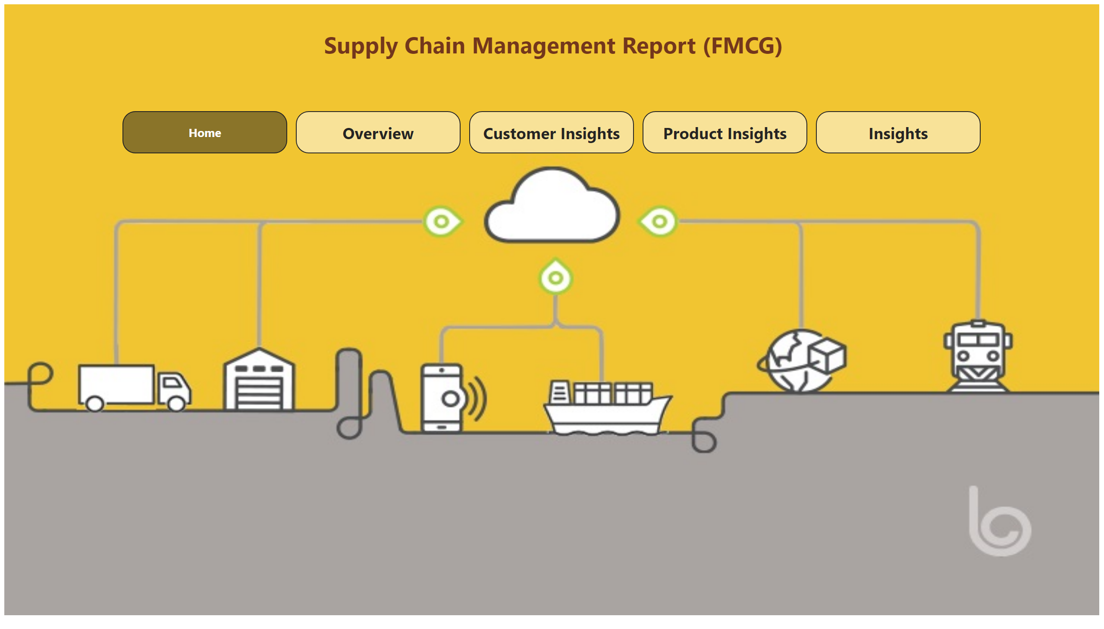
Home
Notes:
image
No alt text provided
pageNavigator
No alt text provided
textbox
No alt text provided

Slide 3
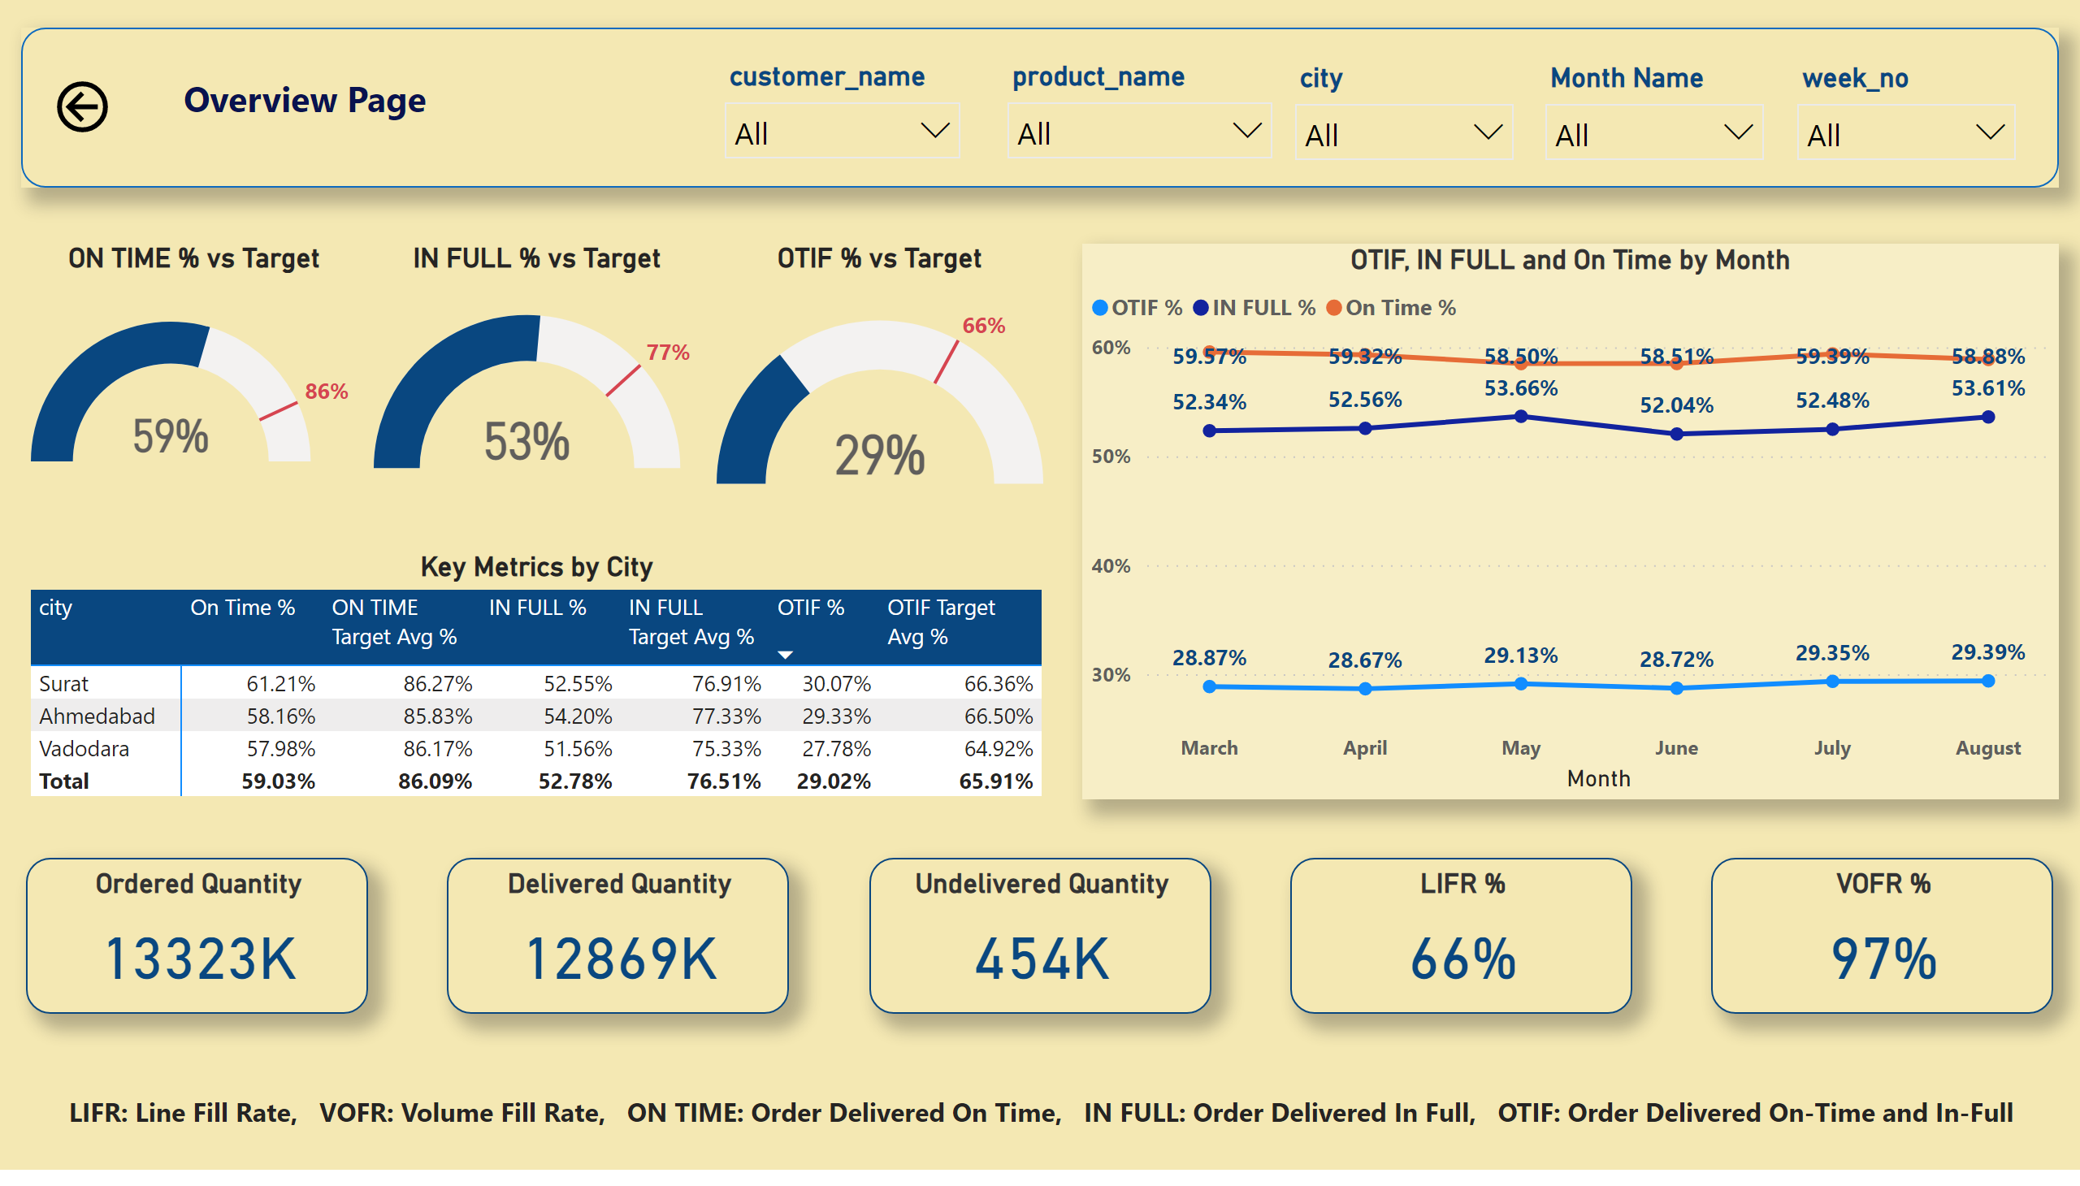
Overview
Notes:
Ordered Quantity
No alt text provided
Delivered Quantity
No alt text provided
Undelivered Quantity
No alt text provided
LIFR %
No alt text provided
VOFR %
No alt text provided
Key Metrics by City
No alt text provided
OTIF, IN FULL and On Time by Month
No alt text provided
ON TIME % vs Target
No alt text provided
IN FULL % vs Target
No alt text provided
OTIF % vs Target
No alt text provided
textbox
No alt text provided
actionButton
No alt text provided
slicer
No alt text provided
slicer
No alt text provided
slicer
No alt text provided
slicer
No alt text provided
slicer
No alt text provided
textbox
No alt text provided
shape
No alt text provided

Slide 4
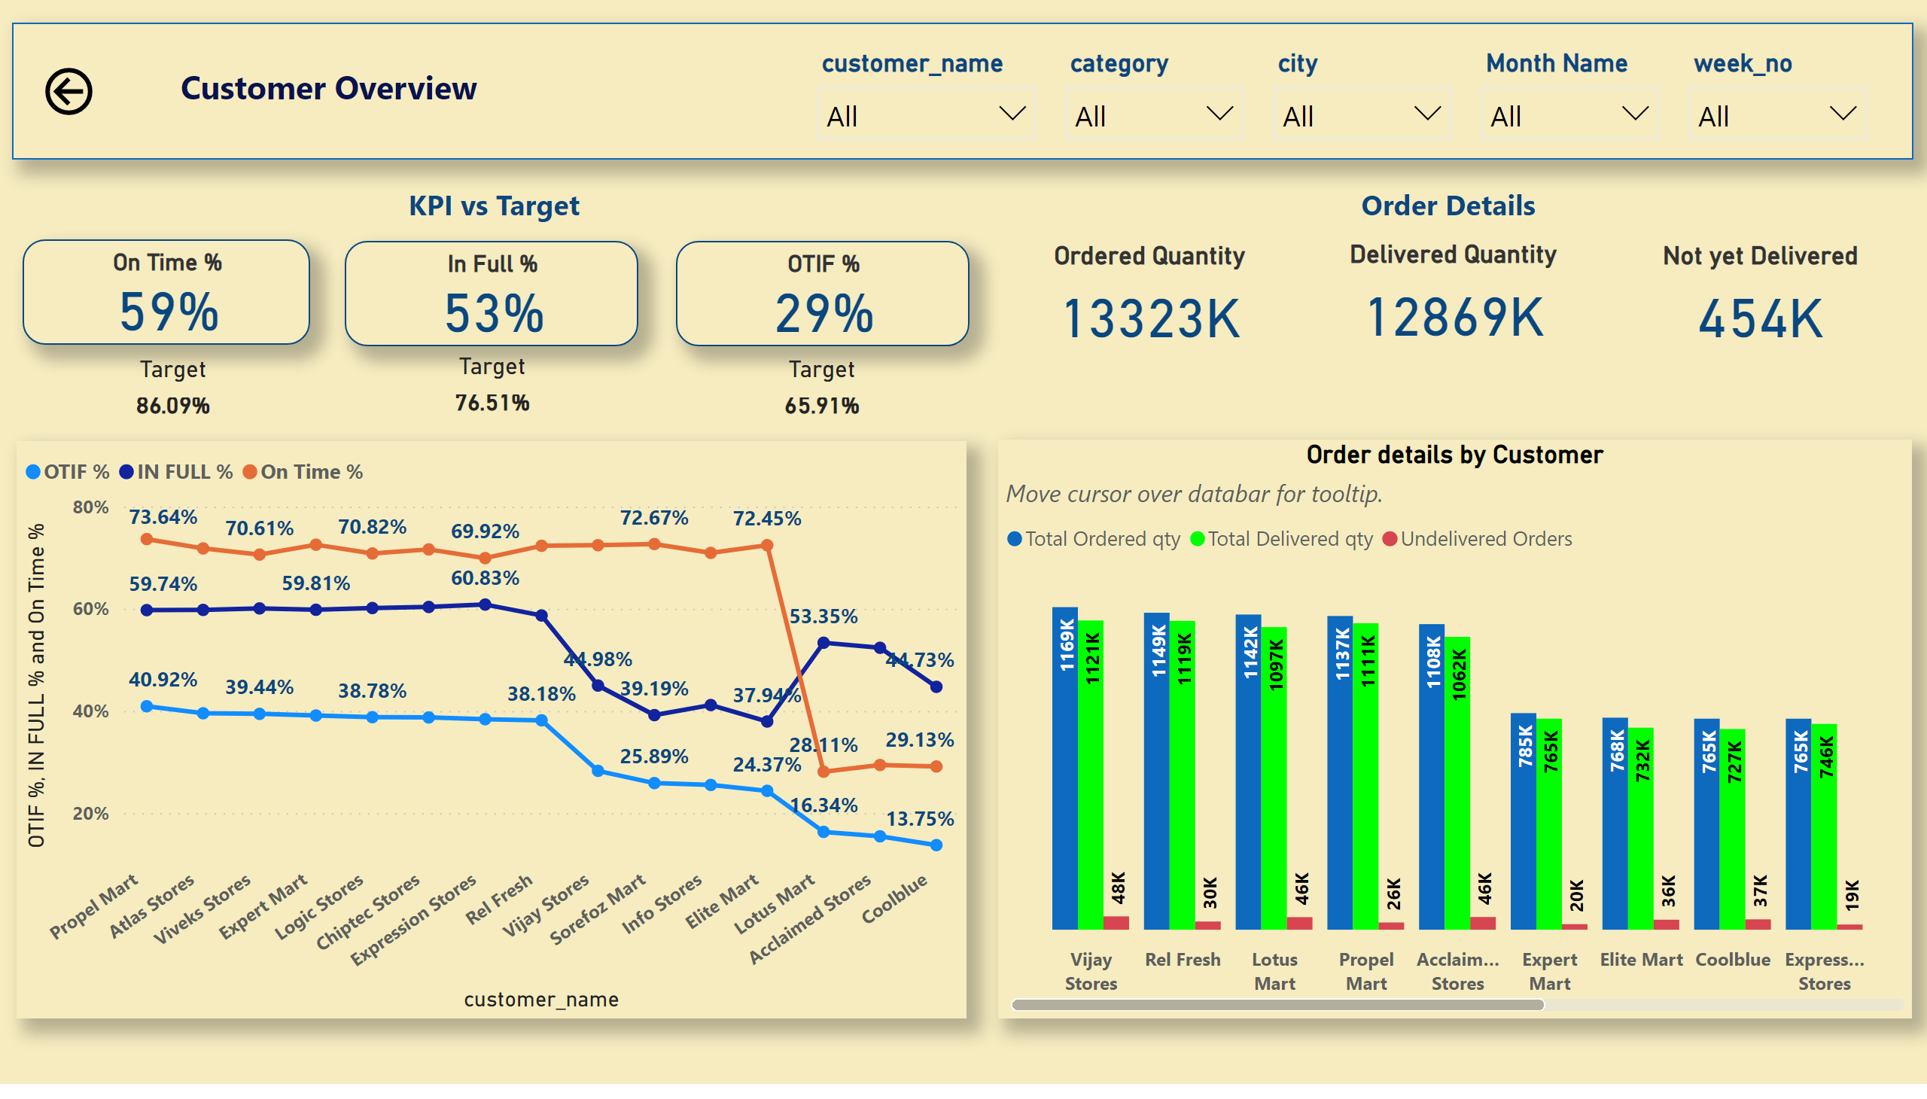
Customer Insights
Notes:
On Time %
No alt text provided
In Full %
No alt text provided
OTIF %
No alt text provided
slicer
No alt text provided
slicer
No alt text provided
slicer
No alt text provided
slicer
No alt text provided
slicer
No alt text provided
textbox
No alt text provided
shape
No alt text provided
shape
No alt text provided
Not yet Delivered
No alt text provided
Delivered Quantity
No alt text provided
Ordered Quantity
No alt text provided
shape
No alt text provided
lineChart
No alt text provided
Order details by Customer
No alt text provided
actionButton
No alt text provided
Target
No alt text provided
Target
No alt text provided
Target
No alt text provided

Slide 5
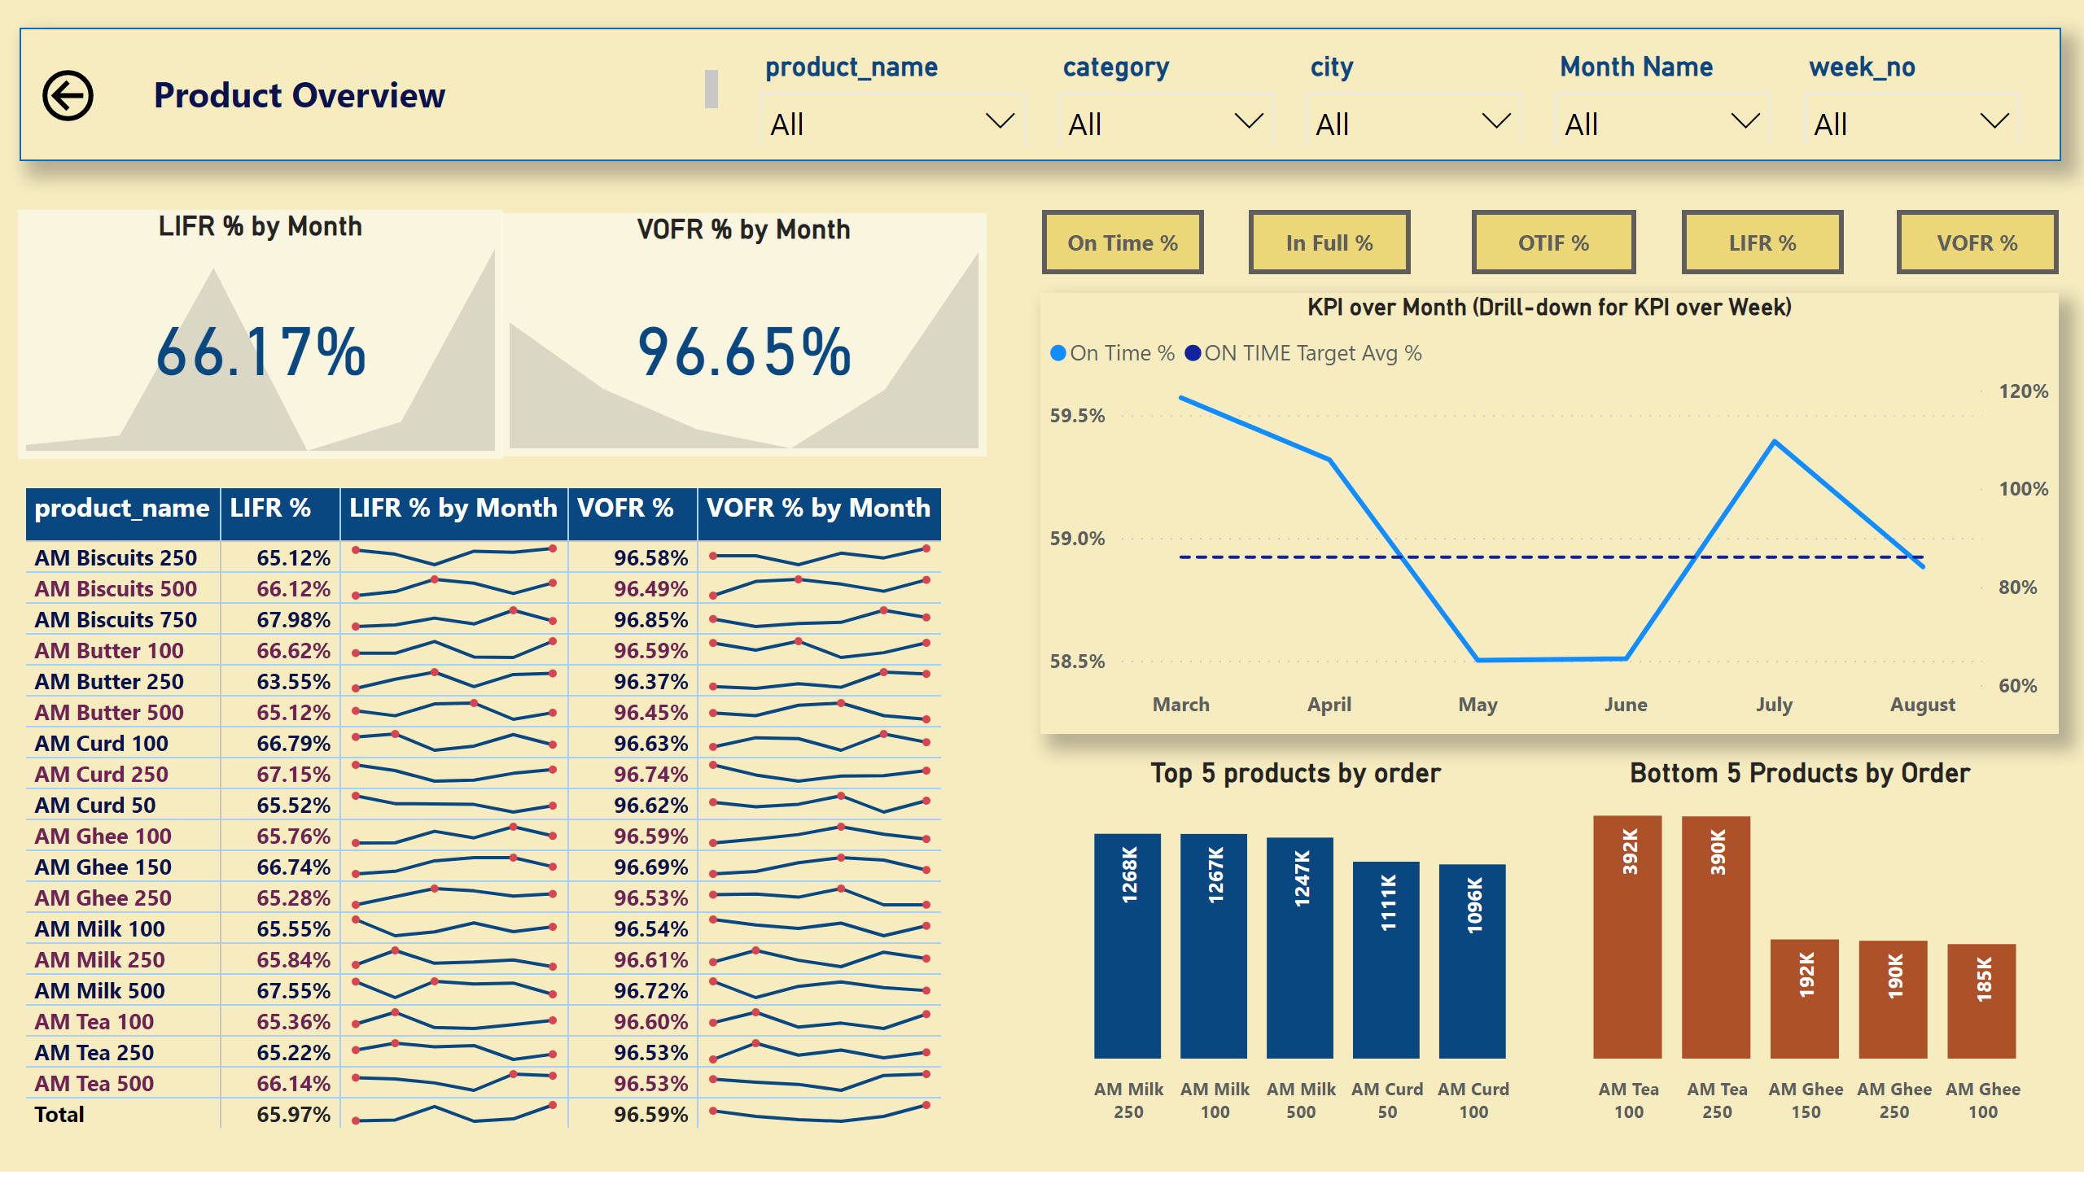
Product Insights
Notes:
actionButton
No alt text provided
actionButton
No alt text provided
actionButton
No alt text provided
actionButton
No alt text provided
actionButton
No alt text provided
KPI over Month (Drill-down for KPI over Week)
No alt text provided
lineChart
No alt text provided
lineChart
No alt text provided
lineChart
No alt text provided
lineChart
No alt text provided
slicer
No alt text provided
slicer
No alt text provided
slicer
No alt text provided
slicer
No alt text provided
slicer
No alt text provided
textbox
No alt text provided
shape
No alt text provided
LIFR % by Month
No alt text provided
VOFR % by Month
No alt text provided
pivotTable
No alt text provided
Top 5 products by order
No alt text provided
Bottom 5 Products by Order
No alt text provided
actionButton
No alt text provided

Slide 6
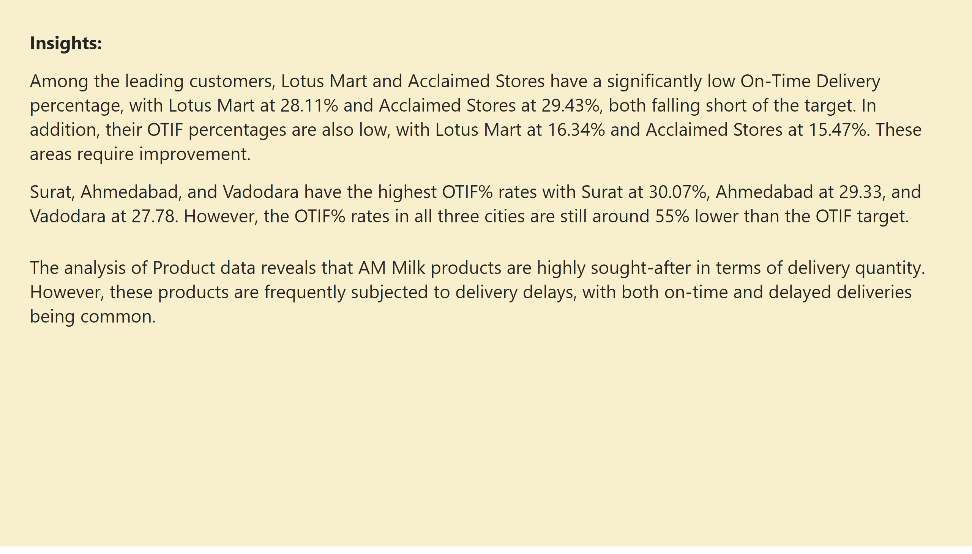
Insights
Notes:
textbox
No alt text provided

